Slide 1




Introduction to Fake News Detection
Fake news has become a problem in the digital age, with the rapid spread of misinformation online. This presentation will explore NLTK library, to build a Logistic Regression model for detecting fake news articles.
by Soumy Bisht

Slide 2


Understanding the Problem of Fake News
1
Defining Fake News
Fabricated or deliberately misleading information presented as news.
2
Prevalence and Impact
Fake news can have severe consequences, influencing public opinion, political discourse, and even social stability.
3
Challenges in Detection
The rapid spread of fake news, complex language patterns, and evolving tactics make it a challenging problem to solve.

Slide 3
Natural Language Processing (NLP) with NLTK
NLTK Overview
Key NLP Tasks
The Natural Language Toolkit (NLTK) is a powerful Python library for working with human language data.
Tokenization, stopword removal, stemming, and sentiment analysis are crucial for fake news detection.

Slide 4
Some of the Libraries used :
Pandas Library
Numpy library
RE library
This library is used for creating data frames for dataset and storing of data.
This is library is used for creating numpy arrays and array manipulation.
It is a regular expression library which is used to search for a text in a document.

Slide 5

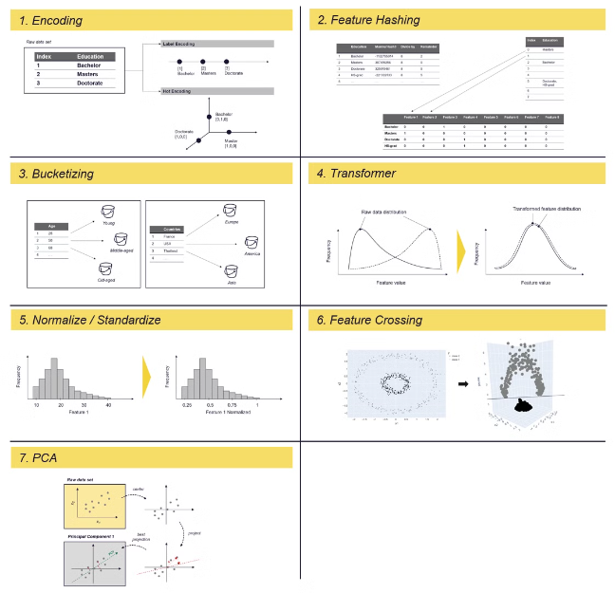
Feature Engineering for Fake News Detection
1
Text-based Features
Analyze the linguistic patterns, sentiment, and writing style of news articles.
2
Metadata Features
Incorporate information about the source, author, and publication date of articles.
3
Network-based Features
Examine the sharing and spreading patterns of news articles on social media.

Slide 6

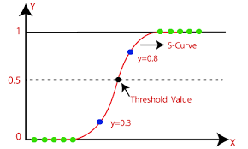
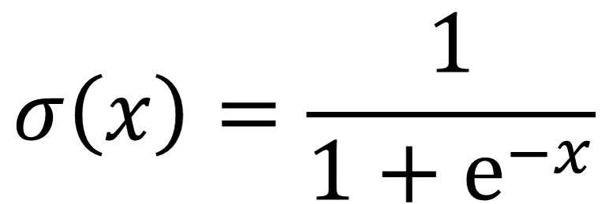
Logistic Regression Model
Logistic regression is one of the types of regression analysis technique, which gets used when the dependent variable is discrete.
Example: 0 or 1, true or false, etc. This means the target variable can have only two values, and a sigmoid curve denotes the relation between the target variable and the independent variable.
Logistic function is used in Logistic Regression to measure the relationship between the target variable and independent variables. Below is the equation that denotes the logistic regression.

Slide 7




Training and Evaluating the Model
Data Preparation
Model Training
Model Evaluation
Model Refinement
Gather and preprocess a dataset of real and fake news articles.
Train the Logistic Regression model on the prepared dataset.
Assess the model's performance using metrics like accuracy, precision, recall, and F1-score.
Iteratively improve the model by adjusting hyperparameters or engineering additional features.

Slide 8

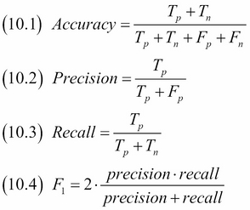
EVALUATION METRICS TERMS:
1
Accuracy Score:
It is a measure of how often our model is able to make the correct predictions.
2
Precision Score:
It measures the accuracy of positive predictions or how often our model is able to make correct positive predictions.
3
Recall Score:
It tells us how often our model is able to identify the positive prediction cases.
4
F1 Score:
It is the weighted average of precision and recall score. It is used when we need to combine precision and recall into a single unit.

Slide 9
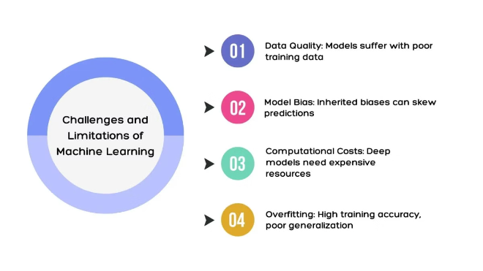
Limitations and Challenges of the Approach
1
Reliance on Training Data
The model's performance is heavily dependent on the quality and diversity of the training dataset.
2
Potential for Bias
The model may inherit biases present in the training data or the feature engineering process.
3
Adaptability to Change
Fake news tactics are constantly evolving, requiring the model to be regularly updated and retrained.
4
Interpretation of Results
The probabilistic nature of the Logistic Regression model may require careful interpretation by users.

Slide 10


Conclusion and Future Directions
This presentation has outlined a comprehensive approach to detecting fake news using NLTK and Logistic Regression. While the proposed system shows promise, ongoing research and development are needed to address the evolving challenges of fake news and enhance the reliability and scalability of the detection model.

